Slide 1

Advanced Design Templates and Sample Projects
Elijah Kerry, Certified LabVIEW Architect (CLA)
Senior Product Manager for LabVIEW, National Instruments
Notes:
Today we’re going to be focusing on one of the more advanced templates in 2012, and more importantly – how we can actually extend the capabilities of the create project dialog

Slide 2
Agenda
Actor Framework Template Walkthrough
Actor Framework Sample Project Walkthrough
Creating Custom Sample Projects and Templates
- Modifying the XML Information
- Overriding MetaData.lvclass
- Customizing the Dialog Options
- Scripting Custom Options

Slide 3
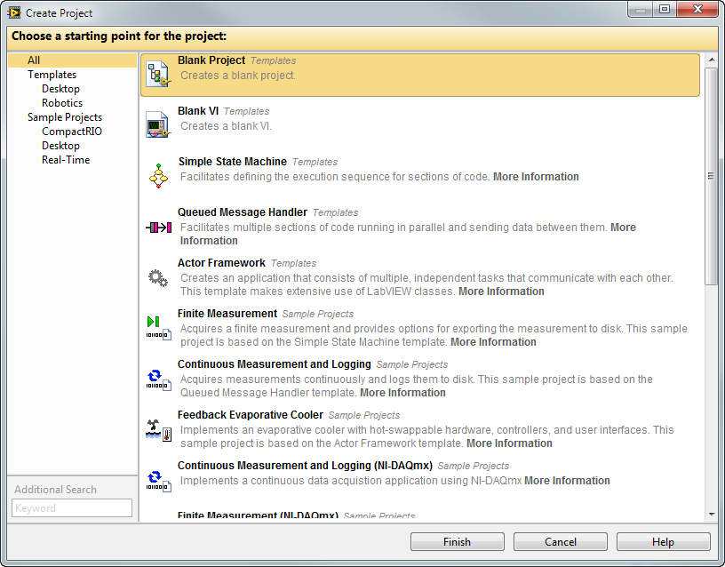
LabVIEW Templates and Sample Projects
Recommended starting points for common LabVIEW applications
Clearly indicates where to add or change functionality
Shows best practices for code design, documentation, and organization
Add custom templates and sample projects
Notes:
In order to ensure we’re

Slide 4
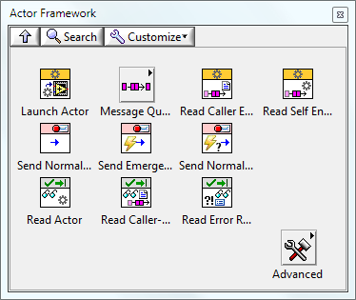
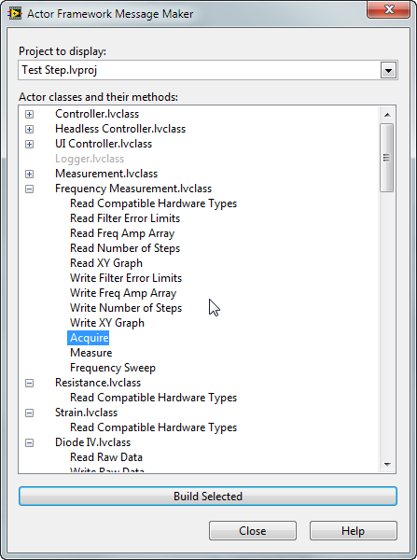
New Framework for Multi-Process Systems
The Actor Framework designed for large multi-process applications
Includes utility for generating messages and invoking actor methods
For more information:
ni.com/actorframework
Makes heavy use of object-oriented programming in order to eliminate duplication of code and improve system scalability
Notes:
Audience: Advanced users
Main Message: The actor framework has been a publically available framework for the last few years. It was designed and validated through use in the community as an object-oriented approach for developing multi-process systems that expands upon a combination of the queued message handler and command pattern approach.
LabVIEW 2012 officially includes the Actor Framework in vi.lib, which means that this is now a productized and supported framework. LabVIEW 2012 includes both a template and a sample project illustrating how to use this new framework. There is also a utility that scripts the creation of message classes, as
Transition: The Actor Framework provides two root classes, one for Actors and the other for Messages.

Slide 5
Creating a Multi-Process System
Best Practices
Identify data scope
Delegate actions to appropriate process
Do not poll or use timeouts*
*except for code that communicates with hardware
Considerations
How do you send commands?
How do you send data?
Which processes can communicate with each other?
How do you update the UI?
Event-Driven Loop
DAQ Application
Notes:
So now that we understand the value of decoupled, highly cohesive processes, this brings up a very important and often challenging question: how exactly do we go about communication between and managing all of these processes?
For starters, we use the data scope that we just talked about as a mechanism to identify who gets send a command or owns certain responsibilities. If another process needs to invoke a function belonging to another process, it immediately delegates that action to the appropriate recipient.
A key example of this is the loop that captures user interaction with the front panel, which absolutely should use an event structure. The event structure only captures user input, so you should do the absolute minimum required in the event-driven loop to ensure that it’s always ready to respond… all of the heavy lifting should be done by separate threads that can be delegated to by the event loop. In all likelihood, the process with an event structure will delegate by sending a message to a consumer, which is what we’re about to explore.
So how do we communicate between these separate processes, and how do we structure the application? Well lets start with the familiar concept of producers and consumers…

Slide 6
Anatomy of a Message Producer Process
Process
Action or Event
Stop Condition Met?
Command
Inter-Process Communication
Data
Message comprised of a command and optional data
Sends message to other process, program, or target
Notes:
When we refer to a ‘message’ we’re using referring to something that is comprised of a command and data. As an example, if the command is ‘get me a soda’ the data might be the type of soda you want someone to get.
So typically in LabVIEW we have to pair the command with the associated data. This is typically done one of two ways:
Everything is flattened to a string and then un-flattened in the receiving case structure
A cluster containing an enum and a variant is used, where the enum is the command and the variant is the data type
These are both effective mechanisms, but they have some drawbacks we’ll see in a second.

Slide 7

Constructing a Message
Data
Variant allows data-type to vary. Different messages may require different data
Command
Enumerated constants list all of the options
Examples
Command | Data
Initialize UI | Cluster containing configuration data
Populate Menu | Array of strings to display in menu
Resize Display | Array of integers [Width, Height]
Load Subpanel | Reference of VI to Load
Insert Header | String
Stop | -
Notes:
These are more realistic examples of commands that are actually being used in the example we looked at. Note the number of different types of data and information we need to combine with each message. When done using a non-oo approach, the most effective method is almost always the one shown here: a variant and an enum. This works well for many programmers, but poses some challenges we’ll look at shortly.

Slide 8

Queued Message Handler Process
After command is executed, data cluster may be updated
Case structure has a case for every command
FIRST STATE
Data cluster for all states
Defines the scope of operations this consumer can handle
Command Execution
State Specific
Data-type Definition
Stop Condition Met?
Queue
Reference
Dequeue
Action & Data
Next Steps
?
Variant To Data
Next steps could enqueue new action for any other loop, including this one
Notes:
And we do this using a variant to data primative. However, as we just saw, this can introduce problems at run-time because we can’t enforce that commands send the correct data

Slide 9
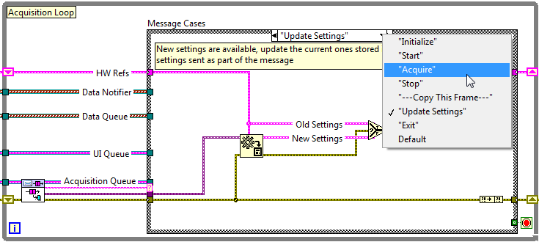
Messages Correspond to the Case Selector
These are the messages this consumer can handle

Slide 10
Scaling Multiple Consumer Systems
Scenario Two: Multiple Instances of Same Process
Queue References
Traditional Solution: Dynamically load VI or duplicate code

Slide 11
Scaling Multiple Consumer Systems
Scenario One: Customize existing behavior
Measurement A
Measurement B
Messages
Configure
Acquire
Measure
Close
Exit
Messages
Configure
Acquire
Measure
Close
Exit
Messages
Configure
Acquire
Measure
Close
Exit
Traditional Solution: Maintain two separate copies

Slide 12
Scaling Multiple Consumer Systems
Scenario Two: Add Additional Capability
Measurement A
Measurement B
Messages
Configure
Acquire
Measure
Close
Exit
Messages
Configure
Acquire
Measure
Close
Exit
Messages
Configure
Acquire
Log
Measure
Close
Exit
Traditional Solution: Maintain two separate copies

Slide 13
Queues Exist for the Lifetime of the Creator
Everyone STOP!
When the creator of a queue leaves memory, the reference is destroyed.
Any items remaining in the buffer will not be read, including ‘Stop’

Slide 14

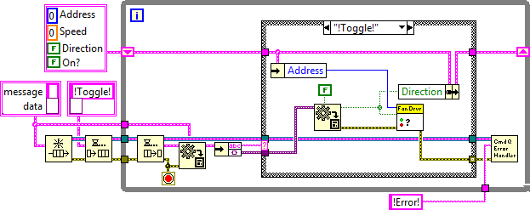
What is an Actor?
₌
An actor is conceptually the same as a queued message handler (QMH) or queued state machine (QSM).

Slide 15
Queue-Driven State Machine
Notes:
This is the queue-driven state machine. I am going to assume that everyone in this room is familiar with this VI pattern. It’s cool, it is the answer to the CLD exam, and we all love it, or something that looks very much like it.
It is powerful and flexible. You can extend it by adding to the internal data cluster or adding new cases, often without changing any existing cases.

Slide 16
Cluster and Node...
Notes:
Let’s start by looking at the internal data of the state machine. That’s a simple cluster; we perform operations on the data in that cluster in each state machine case. A basic guideline for translating standard LabVIEW into classes is that the cluster and node…

Slide 17
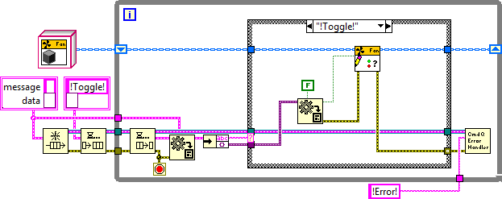
… become Class and Method
Notes:
… become class and method. We have now decoupled the state machine from the details of how the internal data are manipulated in each state. The internal data is now an external instance of a class.
So why is this cool? We now have the option of writing child classes for our state machine, allowing us to change the behavior in each state, without changing the state machine itself. We can even chose to change child classes at run time.

Slide 18
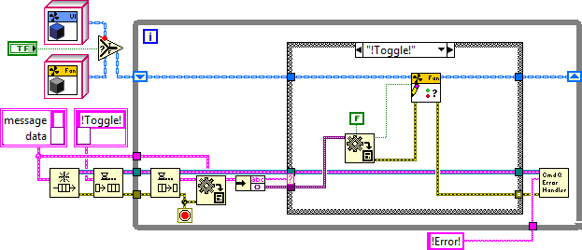
… become Class and Method
Notes:
We can even chose to change child classes at run time.

Slide 19
Message and Case Structure…
Notes:
While we’re thinking about that, let me take a moment to point out another weakness in the original design. Take a look at the structure of our messages (an identifier and a block of data). It is trivially easy for the sender to send either a) an incorrect identifier (an ill formed string or the wrong enumerated type) or b) the wrong data for the identifier.
Object-Oriented techniques give us an answer to both of these challenges.
Our guidelines for going from straight LabVIEW to LabVIEW OO say that a cluster and a case structure…

Slide 20
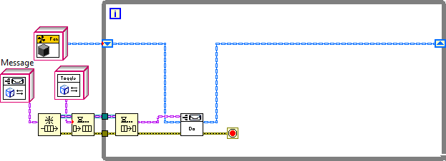
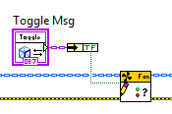
… become Class and Dynamic Dispatch
Notes:
… become a class with dynamic dispatch VIs.
This does three great things for us.
First, our message data is strongly typed, and there is no possibility of sending the wrong data with a command.
Second, we have saved us the work of translating (possibly incorrectly) variants or flattened strings.
Third, we don’t have to change the state machine to add a new operation. We just write a new method for the target class and a corresponding message class to access it. And, provided that the message operates on a parent object, it can be used with any state machine acting on a target object from the same family.
That’s pretty cool.

Slide 21
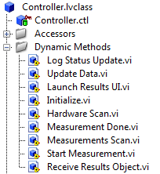
Methods of an Actor are run when a message is received
Log Status Update
Update Data
Launch Results UI
Initialize
Hardware Scan
Measurement Done
₌
Measurement Scan
Start Measurement
Receive Results Object
Methods of an Actor define the messages it can consume

Slide 22
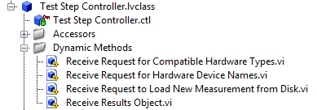
What are the States of the Actor?
Log Status Update
Update Data
Launch Results UI
Initialize
Hardware Scan
Measurement Done
₌
Measurement Scan
Start Measurement
Receive Results Object
Receive Results Object
Overridden
Receive Request for Compatible Hardware Types
Receive Request for Hardware Device Names
Receive Request to Load New Measurement from Disk

Slide 23

Launching Actors and Managing Queues
Actor.lvclass has two queues in the private data
Queue for sending messages to the calling actor
Queue for receiving messages
These are stored in the actor’s private data when launched
Actors that launch another actor should store the new actor’s queue in its own private data

Slide 24
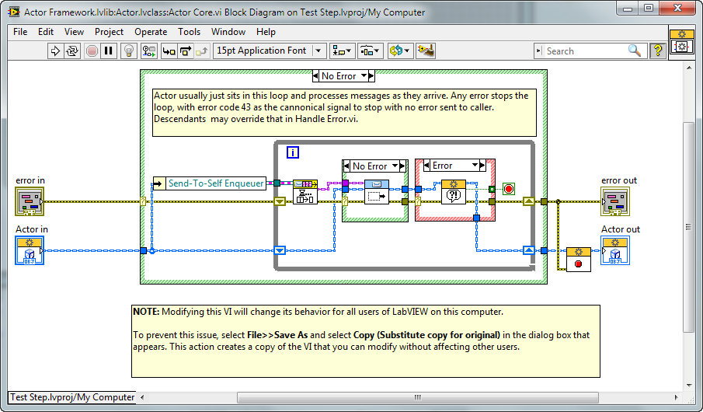
Understanding ‘Actor Core.vi’
This is a queued message handler
Launching an Actor starts the ‘actor core.vi’ method.

Slide 25
When Do You Need to Override ‘Actor Core.vi’ ?
To maintain an additional loop within the Actor
To guarantee certain actions are performed before any messages are handled
To create a unique user interface for a specific Actor

Slide 26
Actor Framework Template Demonstration

Slide 27
Actor Framework Template Relationships
Class Inheritance Hierarchy
Actor.lvclass
Class Inheritance Hierarchy indicates that all three are derived from Actor.lvclass
Beta Actor
Project Actor
Alpha Actor
Task Tree
Project Actor
Task Tree Indicates that the Project Actor launches Alpha and Beta Actors
Beta Actor
Alpha Actor

Slide 28
Project Actor
Alpha Actor
Beta Actor
Launch Alpha Actor
Launch Beta Actor
Alpha Task Msg.lvclass
Log Event.vi
Log Event Msg.lvclass
Task.vi
Event
Timeout
Log Event.vi
Alpha Task Msg.lvclass
Log Event Msg.lvclass
Log Event.vi
Log Event Msg.lvclass
Task.vi
Event
Timeout
Log Event.vi
Log Event Msg.lvclass
Task.vi
Alpha Task Msg.lvclass
Log Event.vi
Log Event Msg.lvclass
Task.vi
Beta Task Msg.lvclass
Log Event.vi
Log Event Msg.lvclass
Alpha Task Msg.lvclass
Log Event.vi
Log Event Msg.lvclass
Task.vi
Event
Timeout
Log Event.vi
Log Event Msg.lvclass
Stop Msg.lvclass
Stop Core.vi
Stop Core.vi
Stop Msg.lvclass
Stop Core.vi
Stop Msg.lvclass

Slide 29
Project Actor
Project Actor
Alpha Actor
Beta Actor
Launch Alpha Actor
Launch Beta Actor
Alpha Task Msg.lvclass
Log Event Msg.lvclass
Log Event.vi
Log Event Msg.lvclass
Task.vi
Log Event.vi
Event
Timeout
Log Event.vi
Log Event.vi
Alpha Task Msg.lvclass
Log Event Msg.lvclass
Log Event Msg.lvclass
Log Event Msg.lvclass
Log Event.vi
Log Event Msg.lvclass
Task.vi
Log Event.vi
Event
Timeout
Log Event.vi
Log Event.vi
Log Event Msg.lvclass
Log Event Msg.lvclass
Task.vi
Alpha Task Msg.lvclass
Log Event Msg.lvclass
Log Event.vi
Log Event Msg.lvclass
Log Event.vi
Task.vi
Beta Task Msg.lvclass
Log Event Msg.lvclass
Log Event.vi
Log Event Msg.lvclass
Log Event.vi
Alpha Task Msg.lvclass
Log Event Msg.lvclass
Log Event.vi
Log Event Msg.lvclass
Task.vi
Log Event.vi
Event
Timeout
Log Event.vi
Log Event.vi
Log Event Msg.lvclass
Log Event Msg.lvclass
Stop Msg.lvclass
Stop Msg.lvclass
Stop Core.vi
Stop Core.vi
Stop Core.vi
Stop Msg.lvclass
Stop Core.vi
Stop Msg.lvclass
Notes:
There is a mistake on this slide, as stop msg.lvclass does not belong to ‘Project Actor.’ It actually belongs to the parent Actor class. Until it’s fixed, use it as a question for the audience

Slide 30
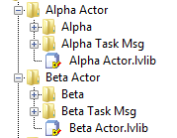
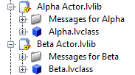
Relationship between Messages and Actors
Messages call a method of an Actor
Messages encapsulate data for that method in the private data control
Messages are therefore coupled to that Actor, but not the children of that Actor
Children may have unique messages, but they are then coupled to those messages
File View
Items Tree

Slide 31
When Do you Need to Override Actor Core.vi ?
To maintain an additional loop within the Actor
To guarantee certain actions are performed before any messages are handled
To create a unique user interface for a specific Actor
Do.vi
Do.vi
Do.vi
Message Handler
Free Running
Event Driven

Slide 32
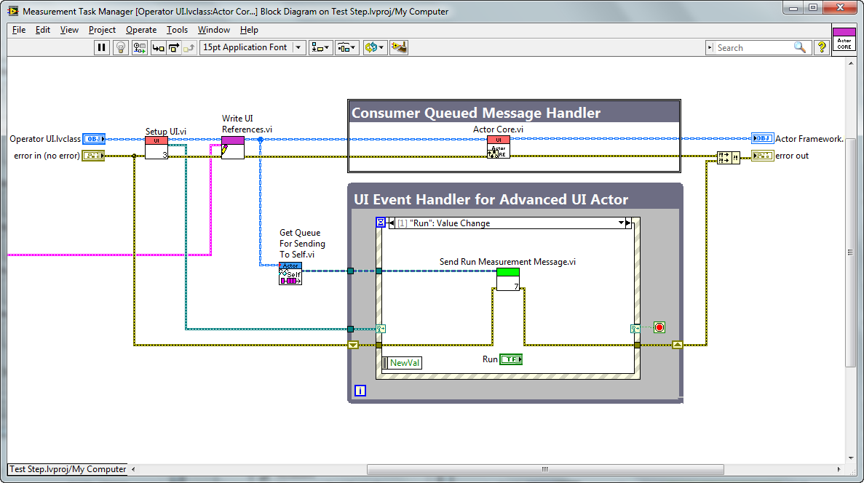
Actor core.vi of Operator UI.lvclass Operator User Interface Block Diagram
Notes:
This is the block diagram of the user interface you just saw. This is typically the only time we need to override the behavior of actor core.

Slide 33
Example Actor Framework Application

Slide 34
Measurement System Sample Project
Class hierarchy view
Actor
How do we communicate between all of these different ‘things’ ?
Controller
Measurement
User Interface
Test Step Controller
Headless Controller
Diode I-V
Strain
Resistance
Operator
Admin
Notes:
So we’ve established that these processes should be separated, which relies on the fact that they’re able to communicate through a controller, but how do you setup and manage that communication? Many people would use queues, which is a perfectly good solution, but it can be challenging as you add additional functionality or even replace certain components.
In a moment we’ll be introducing the Actor Framework and how it works. One of the challenges it helps to address is the communication between these components, and simplifying some of the challenges associated with adding or changing functionality overtime. This makes the actor framework a very valuable tool if you’re concerned with developing highly scalable applications.
Note: from this point forward, instead of referring to these items as separate processes, they shall be called ‘Actors.'

Slide 35
Test Step Task Tree
Task Tree
Controller Actor
User Interface
Measurement
Result

Slide 36
Test Step
Initialize.vi
Initialize Msg.lvclass
Launch UI Msg.lvclass
Launch UI.vi
User Interface
Launch UI Actor
HW Scan.lvclass
Hardware Scan.vi
Initialize.vi
Msmt Scan.lvclass
Msmt Scan.vi
Disp Msmt.vi
Msmt Selected
Initialize Msg.lvclass
Get HW Info.vi
Matching HW.vi
Request HW Msg.lvclass
Available HW Msg.lvclass
Display Hardware.vi
HW Selected
Validate Selection.vi
Check Validty.vi

Slide 37
Test Step
Initialize.vi
Initialize Msg.lvclass
Launch UI Msg.lvclass
Launch UI.vi
User Interface
Launch UI Actor
HW Scan.lvclass
Hardware Scan.vi
Initialize.vi
Msmt Scan.lvclass
Msmt Scan.vi
Disp Msmt.vi
Msmt Selected
Initialize Msg.lvclass
Get HW Info.vi
Matching HW.vi
Request HW Msg.lvclass
Available HW Msg.lvclass
Display Hardware.vi
HW Selected
Validate Selection.vi
Check Validty.vi

Slide 38
HW Selected
Validate Selection.vi
Check Validty.vi
Run Pressed
Send Run Rqst.lvclass
Send Run Request
Start Msmt.vi
Launch Msmt Msg.lvclass
Measurement
Launch Measurement
Checkout HW.vi
Initialize.vi
Config Msmt Msg.lvclass
Configure.vi
Acquire Msg.lvclass
Acquire.vi
Measure Msg.lvclass
Measure.vi
Send Results Msg.lvclass
Receive Results.vi
Close.vi
Stop Msmt Msg.lvclass
Display Results.vi
Display Results Msg.lvclass
Checkin HW.vi

Slide 39
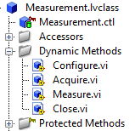
Measurement QSM
Configure
Acquire
Measure
Close
₌
We are going to override Acquire and Measure

Slide 40
Checklist for Creating a Plugin
Project Name: Advanced Sample Project Session
Measurement: NIWeek Demo
Methods:
Acquire
Measure
Hardware
Digital Multimeter (DMM)
Power Supply (PSU)

Slide 41
Adding a Template

Slide 42
Creating a New Template
Required
Create the source code for template
Create the XML document for template
Optional: Scripting on Copied Code
Create a custom scripting method to modify template
Optional: Custom Create Project Dialog
Override the MetaData object (resources folder)
Create a new ‘Spec Page’ (must have required inputs)
Information Available Here

Slide 43
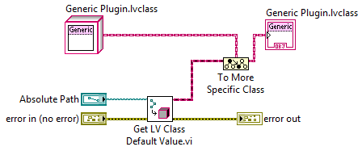


The Basics of an Object Factory
A
B
Objects Loaded Into Memory
C
Generic Measurement
← Parent
Location on Disk
Where Measurements are Stored
A
B
C
← Children
Notes:
Factory pattern is very important and it’s from the gang-of-four. Read up on it here: http://decibel.ni.com/content/docs/DOC-13724

Slide 44
More Information on Architectures and Process Dedicated to LabVIEW Development and Software Engineering Practices
Technical White Paper Series
ni.com/largeapps
Online Community Dedicated to Development Best Practices
ni.com/community/largeapps
Follow My Blog on Software Engineering with LabVIEW
ekerry.wordpress.com
Follow me on Twitter
elijah286

